Slide 1
NORRENBERGER TURBO FUND: A FIXED INCOME FUND

Slide 2
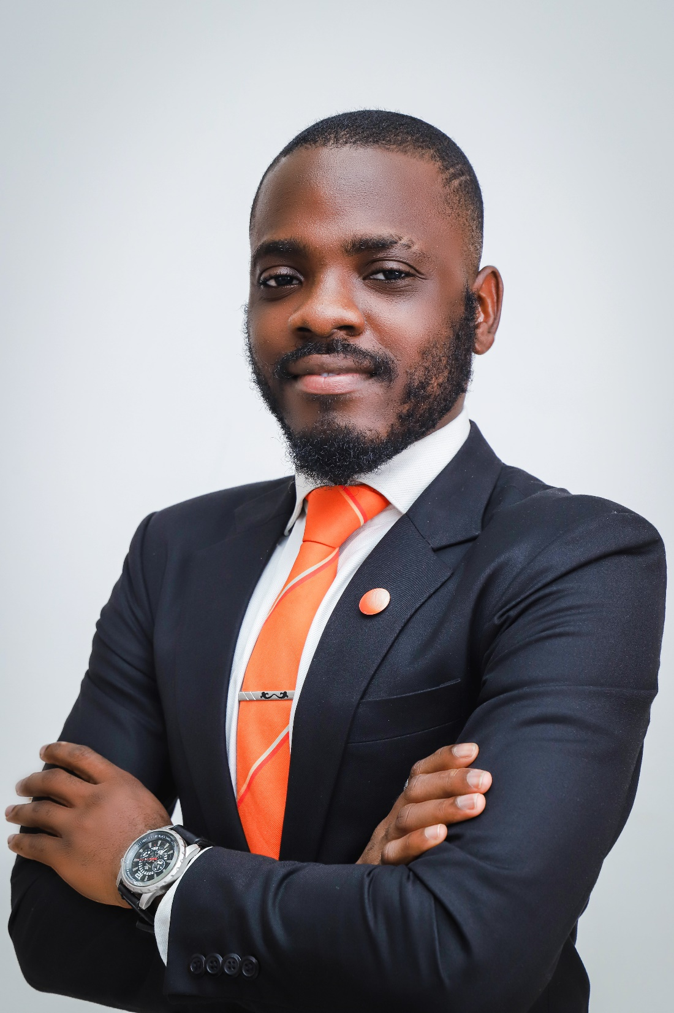
Victor Matthews
Portfolio Management Analyst
Victor is a Portfolio Management Analyst and Fixed Income Trader with the Asset Management team of Norrenberger. He has about 3 years of experience in investment advisory and research. He has garnered experience as a Portfolio Manager and Real Estate Investment Advisor. He is well-versed in trading financial instruments such as Corporate and Sovereign Eurobonds, Federal Government Bonds, Treasury bills, Commercial Papers, Promissory Notes and Equities.
Victor Olamide Matthews started his career in the Abuja Real Estate Industry at MLS Properties where he excelled as an Investment Advisor. During his time there, he was awarded the Commissions Club Award for high-performance. Subsequently, he ventured into Portfolio Management and Fixed Income Trading at Norrenberger Investment and Capital Management Limited.
He holds a bachelor’s degree in Economics from the University of Ibadan, Nigeria. He also possesses several Certifications in the investment advisory and management space.

Slide 3
Table of Contents
01
Introduction
06
Parties To The Fund
02
Mutual Fund Industry Growth
07
Who Should Invest?
03
Norrenberger Turbo Fund
08
How To Invest
04
Features and Benefits Of The Fund
09
How Can I Make Money?
05
Proposed Asset Allocation
10
Yield/Returns Simulation
12
11

Slide 4
1. Introduction

Slide 5
Introduction
What is a Fixed Income Instrument?
A fixed income instrument is an investment which offers investors a predictable income stream and a fixed rate of return. They are debts instruments set to mature within a specified period.
Fixed income instruments offer multiple benefits, including; safety, predictable returns, high liquidity, and portfolio diversification.
What is a Fixed Income Fund?
A fixed income fund is a type of mutual fund that primarily invests in fixed income instruments such as bonds, treasury bills, commercial papers and fixed deposits.

Slide 6
2. Mutual Funds Industry Growth

Slide 7
Fixed Income Funds Industry Growth
Source: SEC
Source: FMDQ
Commentary
The Central Bank of Nigeria (CBN) has been actively combatting inflation by adopting a hawkish approach, which involves increasing the monetary policy rate. In effect, the prices (yields) of bonds held in a fixed income fund's portfolio have declined (increased) since early to mid-2022, resulting in a decrease in the portfolio's value and the fund's net asset value (NAV).
Justification
The Norrenberger Turbo Fund is set to be launched to capitalize on the economic and market phenomenon that makes fixed income instruments more appealing when their prices are low and yields are high.
Current Industry Size: ₦299,618,437,754.17
Share of Global Mutual Funds Industry: 14.75%
Number of Fixed Income Funds: 29

Slide 8
3. Norrenberger Turbo Fund

Slide 9
Norrenberger Turbo Fund
The Norrenberger Turbo Fund is an open-ended Collective investment scheme registered and regulated by the Securities and Exchange Commission (SEC).
The Fund is targeted toward investors with capacity to stay invested for a long period, Institutional investors including Pension Fund Administrators, Insurance Companies, Corporate Entities, Public Sector Agencies and other Asset Managers who seek to diversify their portfolio holdings and earn attractive returns.
Others who form part of the target list include Retail investors with a bias for fixed income investments.
The Fund objective is income generation while maintaining liquidity, diversification, and competitive return. The Fund Manager shall seek to attain this objective within an acceptable level of investment risk. The Fund seeks to provide investors with a low-risk investment and stable and competitive returns by investing in fixed income securities and investment products, while achieving income generation.
There is free entry and exit for investors subject to the prevailing bid and offer price.
NORRENBERGER TURBO FUND
Norrenberger Turbo Fund

Slide 10
Offer Summary
Fund NAME | Norrenberger Turbo Fund
Fund Manager/Promoter | Norrenberger Investment and Capital Management Limited
Trustee To The Fund | DLM Trust Company Limited
Custodian To The Fund | United Bank for Africa PLC
The Offer | Offer for Subscription of 5,000,000 Units of ₦100.00 each at par in the Fund
Nature Of The Fund | The Turbo Fund is an open-ended unit trust scheme constituted under a Trust Deed. The Fund shall invest 100% of it’s assets in a combination of short-term, medium term and long-term securities and investment products approved by SEC in varying proportions.
Investment Objective | The Fund objective is income generation while maintaining liquidity, diversification and competitive return.
Target Investors/Investor Suitability | The Fund is targeted at investors willing to stay invested for longer than 365 days. And institutional investors such as insurance companies and other asset managers looking to diversify their portfolio, interested in fixed income securities.
Offer Size | ₦500,000,000.00
Units of Sale | 5,000,000 units at par value of ₦100 each.
Unit Price | ₦100 per unit
Minimum Subscription | Minimum of 50 units
Payment Terms | Payable in full on application
Commencement Date | 1st November 2023
Minimum Investment Period | The minimum holding period for an investment in the Fund is three months (90 days) from the date of subscription to the Fund. A penalty charge of 20% flat on the accrued income is payable on any redemption effected within 90 days of subscription to the Fund.
Unit Statements | Title to the number at units specified on such statements.
Benchmark | The benchmark is the 3-year Federal Government of Nigeria Bond

Slide 11
4. Features & Benefits of the Fund

Slide 12
Features of the Fund
Risk Profile
Fixed income mutual funds are generally considered to be less risky than equity funds, which invest in stocks.
Liquidity
The fund will provide investors with the flexibility of converting their investment in the fund into cash at any time. Unitholders can redeem their Units within five (5) Business Days of the Fund Manager receiving a valid request.
Lock In Period
The Fund has a minimum lock in period of 90 days, redemptions before the expiration of lock in period will attract a 20% charge on accrued income.
Professionally Managed Fund
The executive and senior management of NICML have over a decade experience in funds management
Diversified Portfolio
Fixed income mutual funds can be a good way to diversify your investment portfolio. Bonds and other debt securities are generally less volatile than stocks, so they can help to reduce the overall risk of your portfolio.
Capital Preservation & Appreciation
Fixed income mutual funds are generally less volatile than equity mutual funds, making them a good option for investors looking to preserve their capital.

Slide 13
Benefits Of The Fund
Ease of Entry and Exit
Competitive Returns
Regular Income
from periodic dividend payments
Portfolio Diversification
Capital Appreciation
Liquidity
Low Cost of Entry

Slide 14
Norrenberger Mutual Funds Comparison
FEATURES | NORRENBERGER TURBO (FIXED INCOME) FUND | NORRENBERGER DOLLAR FUND | NORRENBERGER MONEY MARKET FUND | NORRENBERGER ISLAMIC FUND
Trustee To The Fund | DLM Trust Company Limited | DLM Trust Company Limited | UTL Trust Management Services Limited | UTL Trust Management Services Limited
Custodian To The Fund | United Bank for Africa Plc | Stanbic IBTC Bank Plc | United Bank for Africa PLC | United Bank for Africa PLC
Solicitors To The Fund | The Metropolitan Law Firm | The Metropolitan Law Firm | Templars | Templars
Nature Of The Fund | Invests in Fixed Income Securities such as FGN Bonds, Corporate Bonds, and other Money Market Instruments. | Invests in Eurobonds issued by the FGN and other local Corporates. | Invests in short-term Money Market Instruments from Issuers with credit rating of not less than investment grade.(BBB-) | Invests in Sharia’h Compliant Fixed Income Instruments and Contracts.
Investment Objective | To provide Income Generation, Liquidity, Diversification, Capital Preservation and Competitive Return. | To provide Capital Preservation, Steady Income, Liquidity, Diversification, and Competitive Return. | To provide Capital Preservation, Liquidity, Diversification, Flexibility and Competitive Return. | To provide investors with the opportunity to invest in a professionally managed portfolio of Sharia Compliant Assets.
Target Investors/Investor Suitability | Institutional and retail investors with the capacity to stay invested for longer than 90 days. | Individual and institutional investors who seek dollar denominated investment with capacity to stay invested for longer than 90 days. | Retail investors, High Net-Worth Individuals and Institutions seeking short term investments with flexibility. | Sharia'h Compliant Investors with capacity to stay invested for 180 days or longer.
Units of Sale | Minimum of 50 units and multiples of 10 units thereafter | Minimum of 5 units and multiples of 1 unit thereafter | Minimum of 50 units and multiples of 10 units thereafter | Minimum of 50 units and multiples of 10 units thereafter
Minimum Investment Period/Pre-liquidation charge | 90 days 20% flat on the capital appreciation | 90 days 20% flat on the capital appreciation | 30 days 20% flat on the capital appreciation . | 180 days 20% flat on the capital appreciation
RISK PROFILE | Moderately Conservative | Moderate | Low | Moderate
Benchmark | 3-year Federal Government of Nigeria Bond | 5-year FGN Eurobond | 90 days FGN Treasury bills | 3-year FGN Bond.
Asset Allocation | Bonds 70%-100%; Money Market Instruments 10% - 25%; Cash 0 - 5% | Nigeria Sovereign Bonds 50-100%; Corporate Eurobond 20-100%; Money Market Instruments 0-25%; Cash 0-5% | Short Term Government Securities 60%; Other Money Market Instruments 40%; Cash 0-5% | FGN SUKUK 30-100%; Sharia Compliant Fixed Term Investments 0-70%; Other Sharia Fixed Income Contacts 0-50%; Cash 0-15%
Redemption | Units shall be redeemed at the Bid Price. Unitholders can redeem their Units within 5 (five) Business Days following receipt by the Fund Manager. | Units shall be redeemed at the Bid Price. Unitholders can redeem their Units within 5 (five) Business Days following receipt by the Fund Manager. | Units shall be redeemed at the Bid Price. Unitholders can redeem their Units within 5 Business Days following receipt by the Fund Manager. | Units shall be redeemed at the Bid Price. Unitholders can redeem their Units within 5 Business Days following receipt by the Fund Manager.
NET Yield | 13%-14% | 10.16% | 10.44% | 10.32%

Slide 15
5. Proposed Asset Allocation

Slide 16
Proposed Asset Allocation
ASSET ALLOCATION RANGE
Asset Class | Target Allocation | Asset Allocation Range (%)
Fixed Income Securities: Federal Government of Nigeria bonds Other corporate bonds | 50% 20% | 70 – 100%
Money Market Instruments e.g., Commercial Papers, Fixed deposits, and Certificate of deposits issued by Banks and other financial institutions, whose securities are registered with the SEC. | 25% | 10 – 25%
Cash | 5% | 0-5%
The investments in the asset classes shall be subject to the following limits/restrictions:
Except for Federal government bonds, bonds issued by any single issuer, or one group of companies shall not constitute more than 30% of the Fund’s NAV.
Term Placement with any single institution shall not constitute more than 20% of the Fund’s NAV.
Except for treasury bills, short term money market instruments issued by any single issuer shall not constitute more than 20% of the Fund’s NAV.
Fixed deposits with any single institution shall not constitute more than 20% of a Fund’s NAV

Slide 17
6. Parties to the Fund

Slide 18
Parties to the Fund
B.
Fund Custodian
C.
Trustees to the Fund
B
C
A
D
Parties to the Fund
A.
Fund Manager
D.
Solicitors to the Fund

Slide 19
7. Who Should Invest

Slide 20
Who Should Invest
High Net-Worth
Individuals
(HNIs)
Retail Investors
Other Retail Investors
Norrenberger Turbo Fund
Government Agencies
Institutional Investors
Corporate Organizations
Others

Slide 21
8. How to Invest

Slide 22
How to Invest
Subscription Platforms
SUBSCRIPTION FORM
Investors can invest in the Fund by filling the subscription form of the Fund as well as providing supporting documents (passport photograph, valid means of ID, proof of address and proof of payment).
DIGITAL CHANNELS
Investors will also be able to invest in the Fund through any of our digital channels

Slide 23
9. How can I make Money

Slide 24
How Can I Make Money?
Dividends: Similar to other mutual funds offered by Norrenberger, the Norrenberger Turbo Fund pays dividends on a quarterly basis.
Capital appreciation: Fixed income funds appreciate in value with time progression. This is due to the value of fixed income instruments that the fund invests in and the current interest rate environment.

Slide 25
10. Yield / Returns Simulation

Slide 26
Yield / Returns Simulation
S/N | INSTRUMENTS | FACE VALUE | YIELD | WEIGHT
1 | 13.98 FGN FEB-2028 | ₦80,000,000.00 | 14.13% | 16.00%
2 | 16.25% FGN 2037 BOND | ₦70,000,000.00 | 15.50% | 14.00%
3 | 16.25% FGN 2053 BOND | ₦130,000,000.00 | 16.30% | 26.00%
4 | 16.20 UNION III 27-JUN-2029 | ₦90,000,000.00 | 17.88% | 18.00%
5 | NTB - 22 Aug 24 | ₦25,000,000.00 | 11.00% | 5.00%
6 | Access Bank | ₦35,000,000.00 | 11.50% | 7.00%
7 | Valency CP | ₦30,000,000.00 | 15.00% | 6.00%
8 | MTNN CP V 23-NOV-23 | ₦30,000,000.00 | 12.50% | 6.00%
9 | Cash | ₦10,000,000.00 | 0.00% | 2.00%
 | TOTAL | ₦500,000,000.00 |  | 100.00%
ASSET ALLOCATION
FIXED INCOME SECURITIES | 74.00%
MONEY MARKET INSTRUMENTS | 24.00%
CASH | 2.00%
WAY | 14.89%
Expenses | 2.00%
Net Yield | 12.89%
Projected Net Yield | 12.5%-13.5%

Slide 27
Q&A

