Slide 1
NORREN KICKSTART INVESTMENT
by Habiba Okoli and Ngozi Nnamdi Agwu

Slide 2
DISCLAIMER
This document has been prepared by Norrenberger Investment & Capital Management Limited (“Norrenberger”, “NICML”, or the “Company”). The document is strictly confidential and may not be disclosed to any third party or circulated or referred to or published unless (i) prior written consent is obtained from Norrenberger Investment & Capital Management Limited , or (ii) such action is expressly permitted by a legally binding confidentiality agreement or engagement letter.
Recipients of this document should inform themselves about and observe any applicable legal requirements in their jurisdictions. In particular, the distribution of this document may in certain jurisdictions be restricted by law. Accordingly, recipients represent that they can receive this document without contravention of any applicable legal or regulatory restrictions in the jurisdiction in which they reside or conduct business.
The returns, prices and yields in this document represent indicative rates. Yields, prices and returns will be determined by prevailing market condition at the time of the transaction.
No liability whatsoever is accepted and no representation, warranty or undertaking, express or implied, is or will be made by Norrenberger or any of its respective agents, being its directors, officers, employees, advisers, representatives or other agents, for any information, contained herein or for any errors, omissions or misstatements.
Norrenberger Investment & Capital Management Limited is regulated by the Securities and Exchange Commission. Accordingly, Norrenberger does not provide or review specialist advice (including, but not limited to, legal, regulatory, tax, accounting, actuarial, environmental, real estate valuation or information technology advice) and will not be responsible for the commercial assumptions upon which any advice is based, or the underlying business decision taken by the recipients of this document or any other party. Recipients are recommended to consult their stockbroker, fund/portfolio manager, accountant, banker, solicitor or any other professional adviser for guidance where in doubt and should rely solely on their own judgment, review and analysis of this document.

Slide 4
TABLE OF CONTENT
Product Options
Insurance Options
1
4
7
Introduction
Objective
Benefits of Insurance policy
Strategy
2
5
8
Our Partners
Simulation and Process Flow
3
Features
6
9

Slide 5
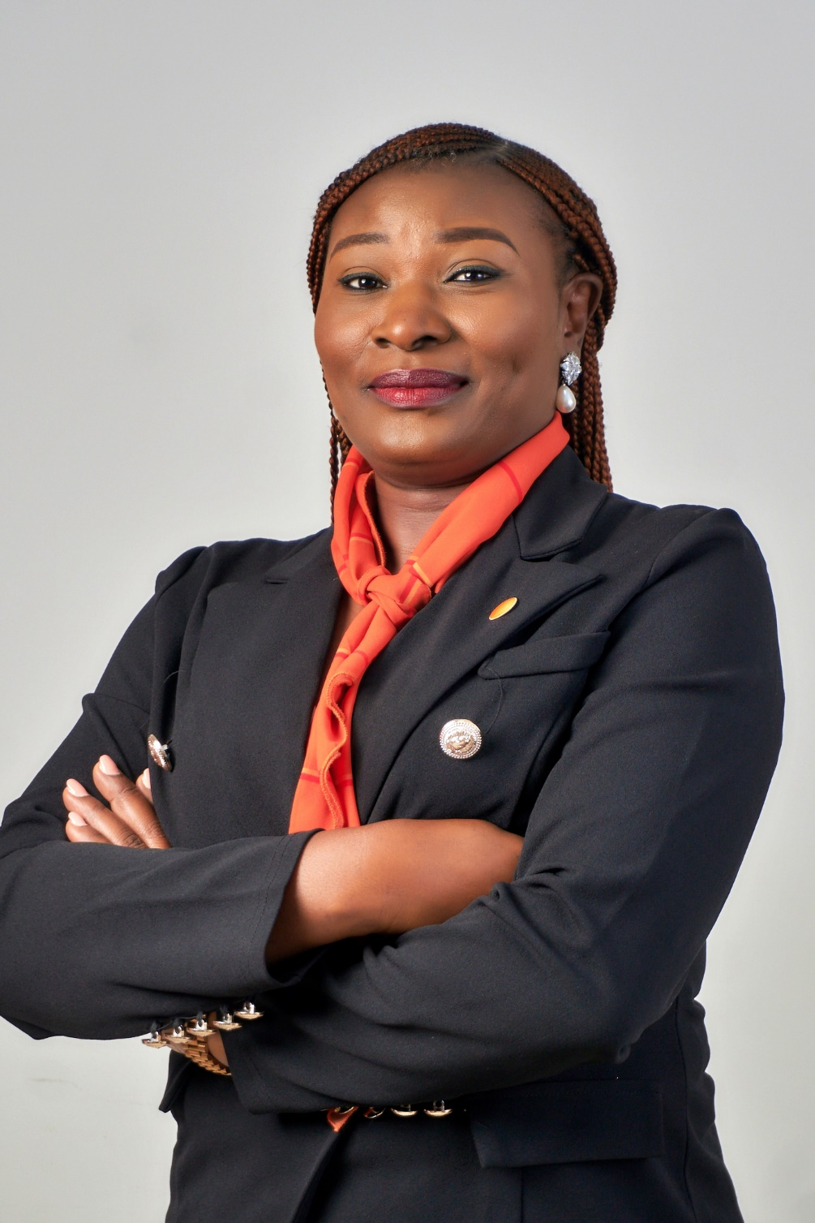
Habiba Okoli
Head, Retail,
Habiba is a solutions-driven and passionate sales and Marketing Professional who currently heads the Retail Team of Norrenberger. She has about 13 years’ experience in financial management combining industry knowledge with an objective for innovation, leadership, and teamwork.
Prior to joining Norrenberger, she worked as the Abuja head of Investment One Financial Group, where she excelled as a Business development professional leading a team of 4 and a trusted financial Adviser, expanding the business through leverage on opportunities and utilizing her network to create value.
Habiba started her career in Asset management with ARM investment Managers where she rose through the ranks to become a team lead, leading a dynamic team of 10 high performers before proceeding to Investment One where she built the business to an enviable AUM position closing in on major transactions.
She holds a Bachelor of Arts (BA English) from the University of Maiduguri and is a certified Fund Manager.

Slide 6
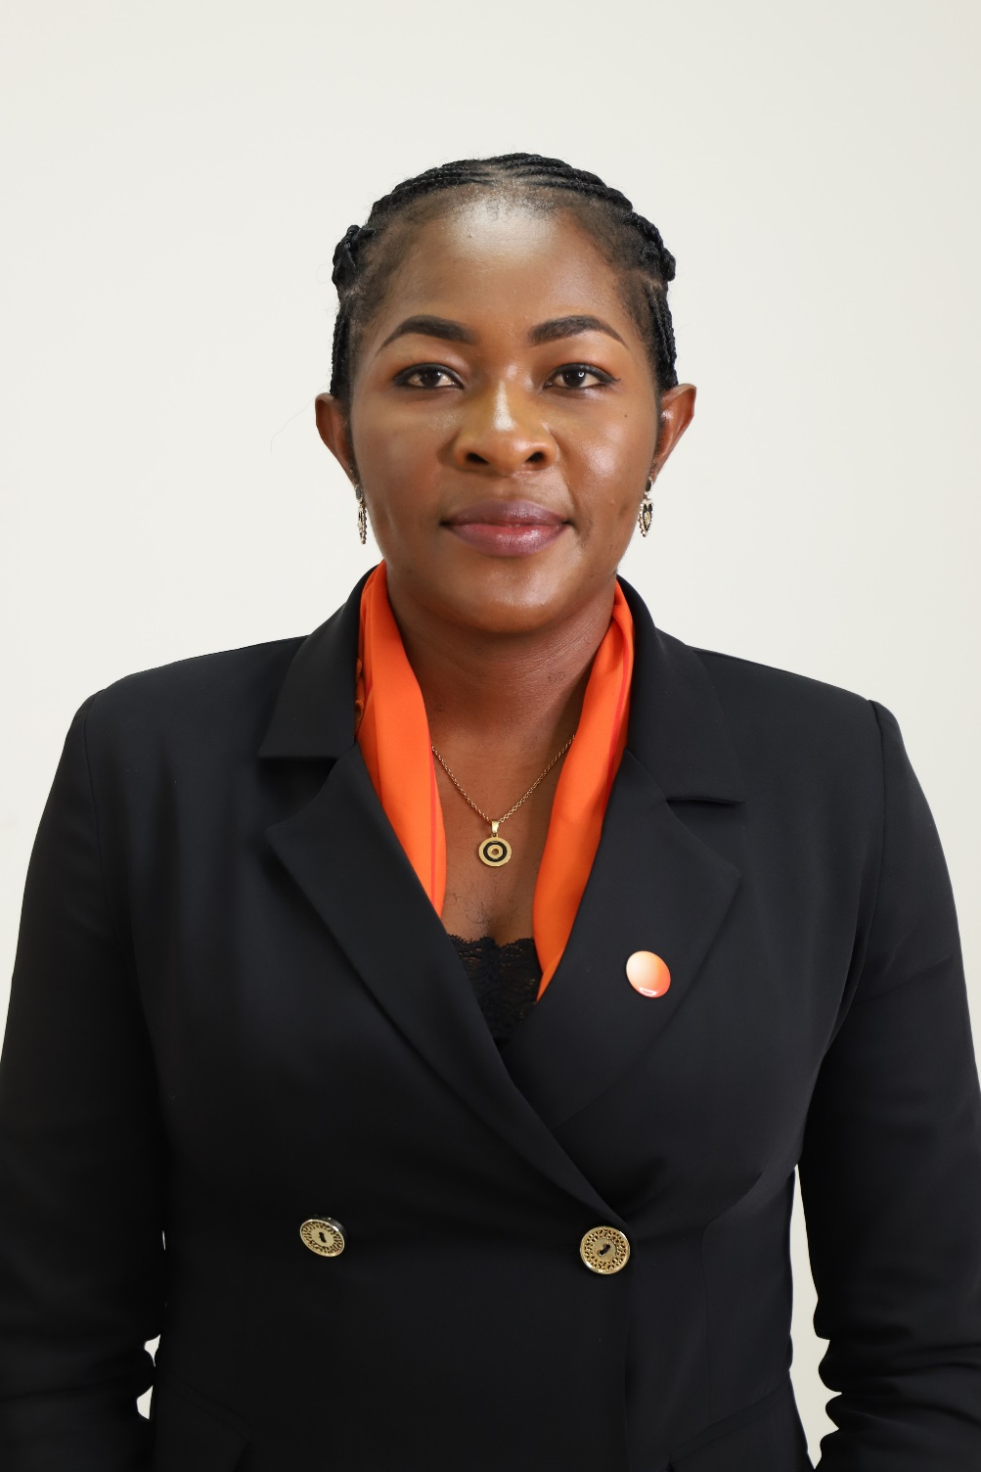
Agwu Ngozi Nnamdi
Sales Intern
Ngozi interns with the asset management team at Norrenberger. She is solution-driven and passionate about her job, and she is a goal-getter, and she has 4 years’ experience in various fields.
Prior to joining Norrenberger, she worked with the National Emergency Management Agency (NEMA) as an Admin Personnel in the Human Resource department, she also worked at the National Centre for Disease Control (NCDC), FCT Abuja as a volunteer during the COVID-19 pandemic as a Sample Collector and a Tester. She has also worked with National Hospital and Amana Medical Centre Abuja as a Laboratory Officer.
Ngozi holds a bachelor’s degree in Microbiology from Bingham University, Karu, Nasarawa State.

Slide 7
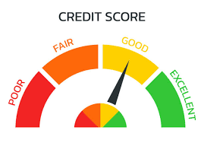
RATING SCORE CARD
Company Rating IM & Credit
BBB-
OUTLOOK: STABLE
A
OUTLOOK: STABLE
NMMF RATING
BBB+
OUTLOOK: STABLE

Slide 8
INTRODUCTION
NORREN KICKSTART INVESTMENT
This investment product is designed to allow parents achieve their dreams and aspirations for their dependents. These may include Education, Upkeep, Entrepreneurial pursuits, Wealth transfer and other futuristic financial goals.
The Norren KickStart Investment ensures the financial security of the named beneficiaries through consistent savings, investment and risk mitigation.

Slide 9
OBJECTIVES
Insurance
Premium subscribers to the product have the option to take a suitable insurance policy to navigate uncertainties (death, demise, disability) that may prevent the achievement of their goals for their dependents.
Dependent’s Welfare
The product enables sponsors to save and invest for their dependents upkeep, maintenance and other financial needs
Financial Planning
The product encourages sponsors to consistently save and invest for the benefit of their dependents
Educational Pursuit
The product enables sponsors to save deliberately for the educational pursuit of their dependents
Entrepreneurial Mentorship
Beneficiaries of this scheme will have access to our School Investment Club and other strategic entrepreneurial coaching programs
Wealth Transfer
Through the product, sponsors can seamlessly transfer their wealth to their named beneficiaries

Slide 10
FEATURES
Minimum initial investment amount of N100,000 and additional investment amount of N10,000.
Account can be opened for dependents from age 0-20 years. Beneficiary takes ownership of the investment at age 21 or as agreed with sponsor.
Fixed and competitive return on investment reviewed semi-annually. Returns are compounded semi-annually.
Full/Part Liquidation of investment is allowed after 5 years without penalty. Liquidation in part or full before 5 years attracts a penalty of 25% on accrued return.
One free annual withdrawal which should not exceed 35% of total investment amount.
Subscribers have the option of purchasing a life insurance cover.
At the demise of the sponsor, the named administrator/executor manages the account. Upon attaining age 21 or the agreed age, the account balance is transferred to the named beneficiaries.
At the demise of a named beneficiary, benefits of the deceased will be transferred to the other beneficiaries in their existing proportion.
04
08

Slide 11
PRODUCT OPTIONS
NORREN KICKSTART INVESTMENT HAS TWO VARIANTS
CONVENTIONAL
HALAL
KICKSTARTL
REGULAR - Norren Kickstart Only
PREMIUM - Norren Kickstart + Insurance
REGULAR - Norren Kickstart Halal Only
PREMIUM - Norren Kickstart + Takaful

Slide 12
BENEFITS OF TAKING AN INSURANCE POLICY
The goals and aspirations of the Sponsor for his or her dependents is achieved in the event of demise due to payment of the sum assured to the Investment Account.
The Sponsor is assured of the fiduciary duty of the Fund Manager to ensure payment is received from the Insurance company and managed professional to maximize returns.
Bulk sum received increases the income generation capacity of the investment and brings investors closer to their goals.

Slide 13
OUR INSURANCE PARTNERS

Slide 14
INSURANCE OPTIONS
NON- CONVENTIONAL INSURANCE
TERM LIFE INSURANCE POLICY
WHOLE LIFE INSURANCE POLICY
Takaful is a financial protection for the beneficiaries of the deceased (or insured) against future unexpected financial risk. According to their religious beliefs.
The sum assured is paid into the Norren Kickstart Investment upon death or permanent disability of the sponsor specifically for the beneficiary(s) education.
This policy was developed to guarantee the payment of an agreed sum to the dependent in the event of death at any time within the duration of the policy.
It’s an annually renewable policy.
The sum assured is paid into the Norren Kickstart Investment upon death or permanent disability of the sponsor any time within the duration of the policy.
This policy provides death cover throughout the life of the insured.
The sum assured is paid into the Norren Kickstart Investment upon death or permanent disability of the sponsor.
Whole life insurance lasts for an insured's lifetime, as opposed to Term life insurance, which is for a specific amount of years
Note:

Slide 15
INSURANCE OPTIONS
AXA MANSARD
CUSTODIAN LIFE
LEADWAY ASSURANCE
Term Life Assurance
Term life insurance is a policy that provides cover for the family or loved ones in the case of death or demise of the policy holder within the policy term.
Cash Backed Term Life
Cash Back Term Life provides Life cover for a specific period, if there are no
claims within the agreed period of cover, 50% cash back of total premiums paid on
the policy will be given back to the policy holder at end of policy term.
Whole Life Insurance
Whole Life Assurance policy covers the insured for life. It is a permanent policy. Depending on the length of premium payment
Term Life Insurance
Term life insurance is a policy that provides cover for the family or loved ones in the case of death or demise of the policy holder within the policy term.
A predetermined sum is paid to the named beneficiary(s) in case the risk occurs.
Whole Life Plan
This policy guarantees the sum assured any time death occurs.
Endowment Plan Lifetime Harvest
This policy provides cover of a specified sum in case of unfortunate death of the policy holder or payment of maturity value if the policy holder outlives the duration or term of the policy.
Term Life Insurance
Term life insurance is a policy that provides cover for the family or loved ones in the case of death or demise of the policy holder within the policy term.
A predetermined sum is paid to the named beneficiary(s) in case the risk occurs.
Critical illness, Accident, Permanent and Total Disability have a separate premium plan (APTD)
Note:

Slide 16
TAKAFUL INSURANCE OPTIONS
Takaful is a financial protection for the beneficiaries of the deceased (or insured) against future unexpected financial risk. According to their religious beliefs.
Mutual risk sharing among insurers. Surplus sharing is made according to participants. No claim cash back is received from the insurance provider if no claim is made within the coverage period.
Takaful is a financial protection for the beneficiaries of the deceased (or insured) against future unexpected financial risk. According to their religious beliefs.
Mutual risk sharing among insurers. Surplus sharing is made according to participants. No claim cash back is received from the insurance provider if no claim is made within the coverage period.
The sum assured is paid into the Norren Kickstart Investment upon death or permanent disability of the sponsor any time within the duration of the policy

Slide 17
INTRODUCTION TO NORRENBERGER SCHOOL INVESTMENT CLUB
The Norrenberger School Investment Club (NSIC) is one of our strategic initiatives to promote financial literacy, investment enlightenment and financial inclusion.
Norrenberger School Investment Club is a terrific way for kids to learn about investment even at a young age (catch them young)
NSIC can help kids learn about money and teach them invaluable lessons about money decisions.
The goal of this Investment Club is to provide simple steps for limited ability to invest. The whole idea is to make investment fun and also encourage them to save and invest their own money.
There would be an inter-school competition, a national competition and the finale which will be at the regional level.

Slide 18
OBJECTIVES OF NORRENBERGER SCHOOL INVESTMENT CLUB
Norrenberger school investment club will provide the student with skills and knowledge that will enhance family finances.
The various activities of the investment club will build confidence and leadership in the student.
It will create an opportunity for the student to practice sound investment habits.
It is also a platform for them to be exposed to the world of finance.

Slide 19
CUSTOMER ONLINE ONBOARDING PROCESS
START
VERIFY EMAIL ADDRESS VIA LINK SENT TO EMAIL ADDRESS
USER CLICKS ON OPEN KICKSTART ACCOUNT ON PORTAL/MOBILE APP
USER LOGS IN USING THEIR EMAIL ADDRESS AND PASSWORD
USER ENTERS EMAIL ADDRESS AND PASSWORD
COMPLETE BIO DATA FORM (add Insurance)
ACCEPT TERMS AND CONDITIONS PECLIAR TO THE PRODUCT SELECTED
VALIDATE KYC
USER UPLOADS CUSTOMER KYC DOCUMENTS
SAVE AND CONTINUE LATER?
Call respective insurance APIs
END
SUBMIT
SELECT FUNDING OPTION
Push collected data from portal to Norren flow
SYTEM GRANTS ACCESS TO USER
Notes:
This template was inserted from Power-user, the productivity add-in for PowerPoint, Excel and Word.
Install Power-user to access thousands of templates, icons, maps, diagrams and charts with Power-user.
Visit https://www.powerusersoftwares.com/
©Power-user SAS, terms of license: https://www.powerusersoftwares.com/terms

Slide 20
CUSTOMER ONBOARDING PROCESS FLOW
Account Opening Form
KYC
Account Created
Notification received
Funding
Customer fills NKI account Opening form which can be used for NKI premium if chosen.
Customer provides KYC documents and biodata for chosen package. T&C checked.
NKI account is created for customers on the regular and premium packages
Prospect receives notification of account created
Prospect funds relevant account. And pays premium
Onboarding
Customer receives notification of funded account and log in access

